Slide 1
The Linux Command Line Chapter 3
Exploring the System
Prepared by Dr. Reyes, New York City College of Technology

Slide 2
Linux Filenames Facts
Filenames that begin with a period character are hidden. To display them use ls –a
Filenames are case sensitive
In Linux there are no file extensions such as .doc or .exe
Avoid using spaces and special characters even if is supported.

Slide 3
Other uses of ls
Try the following options with ls
ls /usr
ls ~ /usr
ls – l
Most commands have options and arguments
command –options arguments
options might be a dash and a single character or two dashes followed by a word

Slide 4
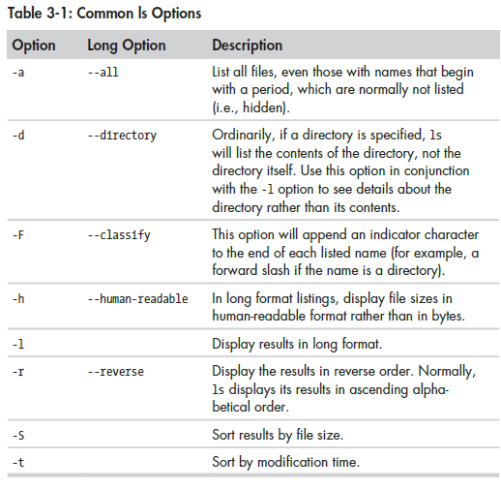
ls Options

Slide 5
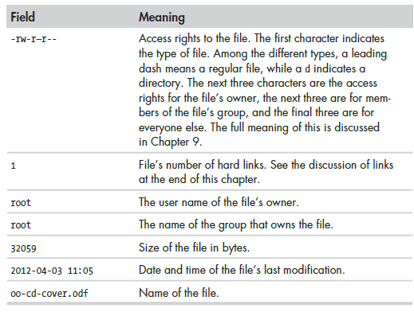
ls –l What all that means?

Slide 6
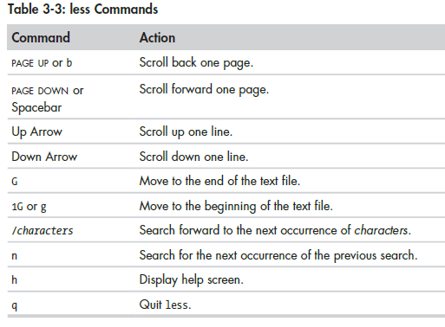
Commands for files
To get the file type
file filename
To read a file
less filename
less is better than more

Slide 7
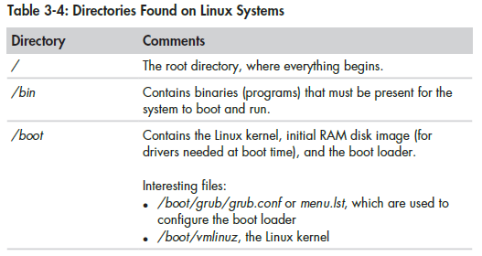
Some Linux Directories

Slide 8
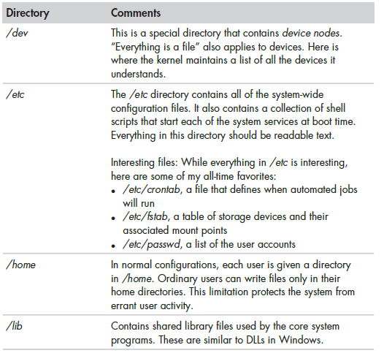
Some Linux Directories

Slide 9
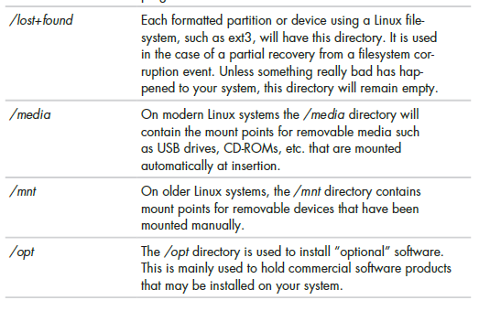
Some Linux Directories

Slide 10
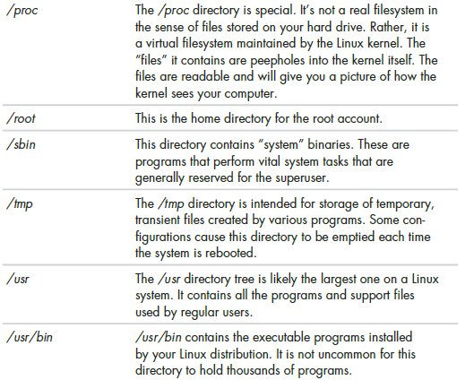
Some Linux Directories

Slide 11
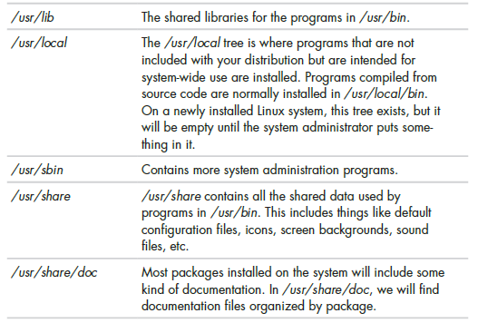
Some Linux Directories

Slide 12
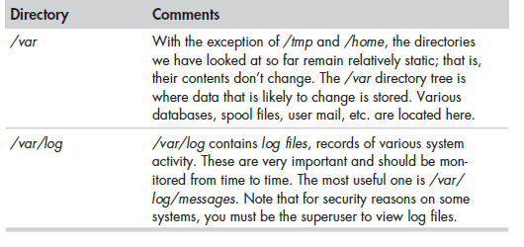
Some Linux Directories

